Slide 1
BrightTV
Viewership Analytics &
Growth Strategy
Insights for the CVM Team · Subscription Growth FY
Analysis period: 2016-01-01 → 2016-04-01 (SA Time)

Slide 2
Agenda
What we will cover today
01
Dataset & Methodology
How we cleaned and prepared 10K sessions
02
User & Usage Trends
Who watches BrightTV and when
03
Drivers of Consumption
Factors that influence viewing
04
Low-Consumption Days
Content recommendations
05
Growth Initiatives
How to expand the user base
BrightTV · Viewership Analytics

Slide 3
Dataset & Methodology
Two sources, one consolidated view
USER PROFILES
VIEWERSHIP
5,375
10,000
Subscribers with demographics:
Name, Gender, Race, Age, Province
Session records:
UserID, Channel, Date/Time, Duration
Preparation steps
UTC → SA
Duration → seconds
Joined sources
Derived fields
Converted all timestamps to UTC+2
Parsed HH:MM:SS for arithmetic
Profile match rate: 100%
Hour, Day of week, Age group
BrightTV · Viewership Analytics

Slide 4
BrightTV at a Glance
Three months of viewing activity
10,000
4,080
1,498
9.4 min
Total sessions
Unique viewers
Hours watched
Avg session length
Key reads
• Active engaged base: 4,080 viewers across 10,000 sessions
• Profile coverage is complete — every session can be tied to a subscriber profile
• Average session ~9.4 minutes — short-form viewing dominates
• Profile base of 5,375 vs 4,080 active = ~76% activation rate (clear win-back opportunity)
BrightTV · Viewership Analytics

Slide 5
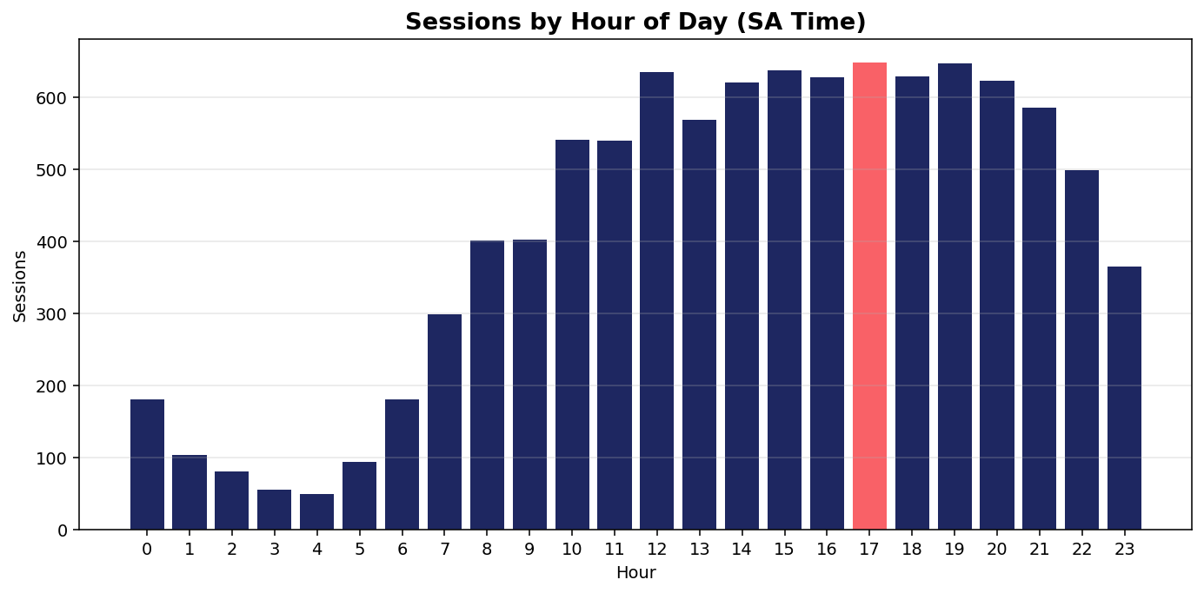
When People Watch
Sessions by hour of day (SA time)
KEY TAKEAWAY
Prime time peaks at 17:00
• Evening 17:00–22:00 is the consumption sweet spot
• Morning (06:00–09:00) is a secondary commute window
• Schedule premium content & promos to align with these windows
BrightTV · Viewership Analytics

Slide 6
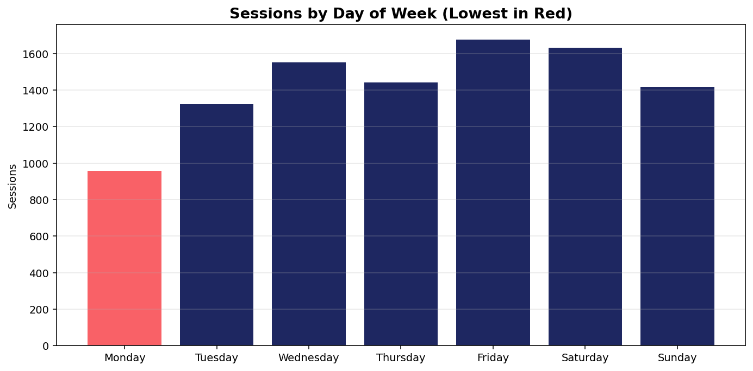
Weekly Rhythm
Sessions by day of week — lowest day in red
KEY TAKEAWAY
Monday is the weak point
• Monday: 957 sessions (weakest)
• Friday: 1,675 sessions (strongest)
• ~75% gap between best and worst day
• Clear opportunity to lift Monday with targeted content
BrightTV · Viewership Analytics

Slide 7
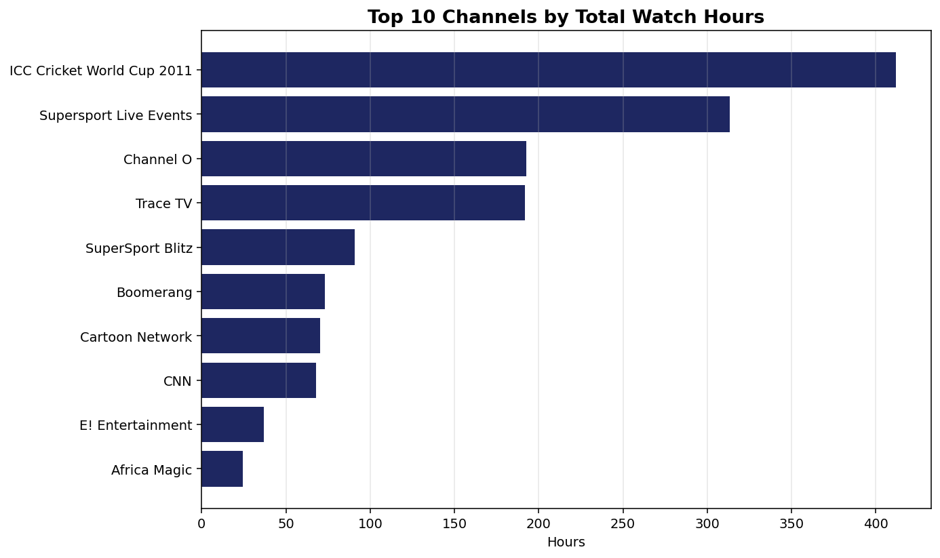
What People Watch
Top 10 channels by total hours streamed
KEY TAKEAWAY
Sport leads — "ICC Cricket World Cup 2011"
• Live sports drive longest watch time
• Music and entertainment channels follow
• Long-tail of niche channels — opportunity to consolidate
BrightTV · Viewership Analytics

Slide 8
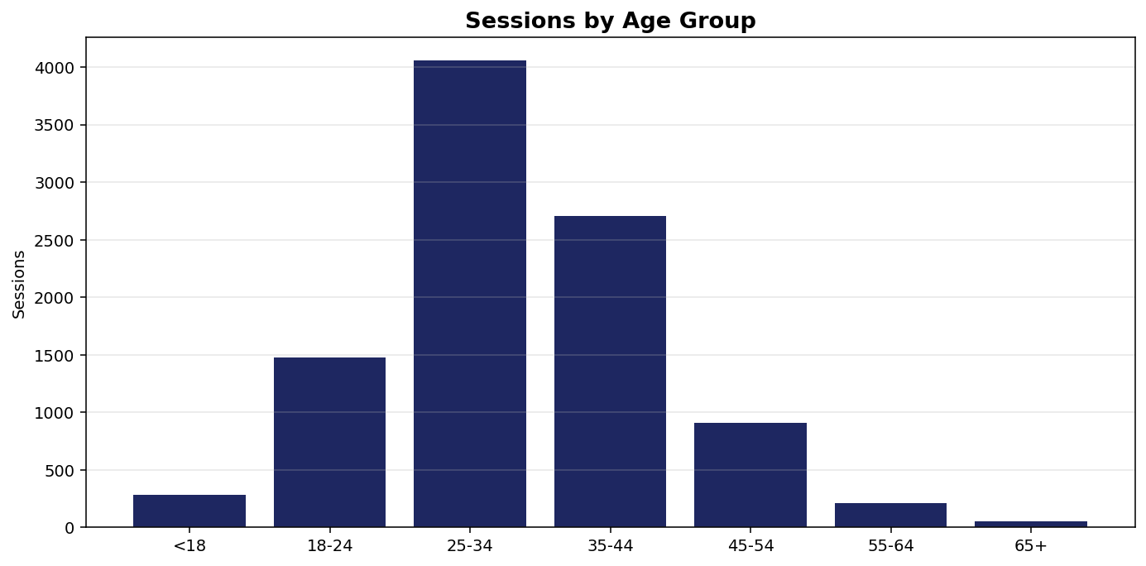
Who Watches — Age
Sessions by age group
KEY TAKEAWAY
Core audience: 25-34
• Millennials (25-44) dominate consumption
• Strong sub-base in 45-54 — premium ad value
• Under-25 segment is under-indexed → growth lever
BrightTV · Viewership Analytics

Slide 9
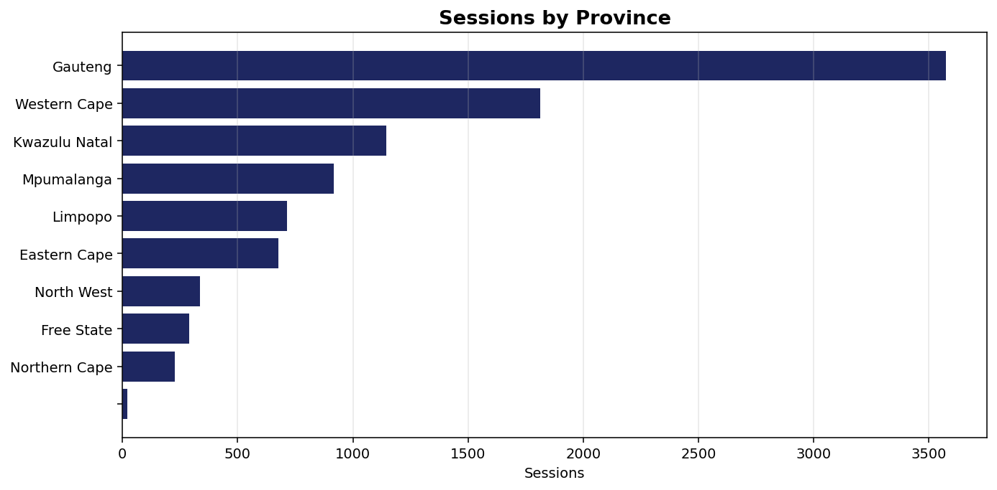
Who Watches — Geography
Sessions by South African province
KEY TAKEAWAY
Gauteng leads the country
• Urban provinces (Gauteng, Western Cape, KZN) drive volume
• Rural provinces remain under-penetrated
• Geo-targeted campaigns can rebalance growth
BrightTV · Viewership Analytics

Slide 10
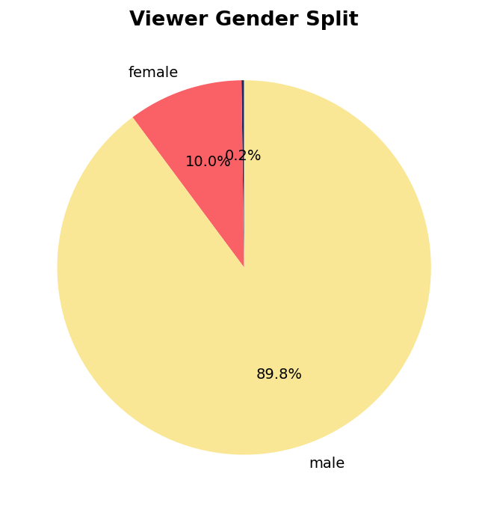
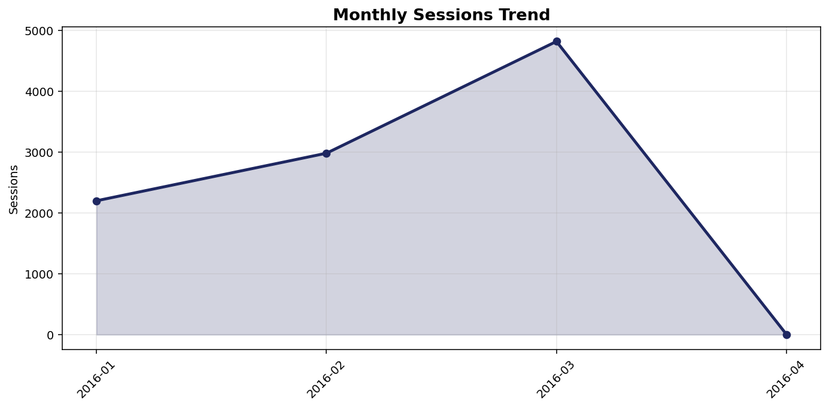
Audience Mix & Trend
Gender split and monthly trajectory
BrightTV · Viewership Analytics

Slide 11
What Influences Consumption?
Five factors observed in the data
TIME OF DAY
Evening 17:00–22:00 captures the bulk of sessions; mornings spike again at commute hours.
DAY OF WEEK
Friday peaks (1,675); Monday drops to 957. Weekends outperform mid-week.
CONTENT TYPE
Live sport (Cricket, Supersport) and music (Trace, Channel O) drive longest sessions.
AGE GROUP
25–34 dominate; <25 and 65+ are light users — under-served opportunity.
GEOGRAPHY
Gauteng, Western Cape, KZN over-index; rural provinces lag — likely connectivity & device gaps.
BrightTV · Viewership Analytics

Slide 12
Lifting Mondays
Content recommendations for the lowest-consumption day (957 sessions)
WHAT ALREADY WORKS ON MONDAY
RECOMMENDED CONTENT PLAYS
1.
Channel O
▸ "Music Monday" block
Curated Channel O / Trace blocks 17–22h with live DJ sets
2.
Trace TV
▸ Sport mid-week kick-off
3.
Supersport Live Events
Monday Night highlights + behind-the-scenes from weekend matches
4.
Cartoon Network
▸ Binge premiere slot
5.
Africa Magic
Drop new series episodes on Monday to anchor the week
▸ Family early-evening
Cartoon Network + Africa Magic combo for 17–19h family slot
Music & entertainment dominate Mondays — viewers want low-effort, mood-lifting content after the weekend.
▸ Push notification window
Send "what to watch tonight" push at 17:00 SA time
BrightTV · Viewership Analytics

Slide 13
Growing the BrightTV User Base
Five initiatives for the CVM team
1
Reactivate dormant
profiles
2
Youth acquisition
(Under-25)
3
Provincial expansion
~24% of profiles were inactive in the period. Win-back email + 7-day free premium trial.
Under-indexed segment. Partner with local artists, TikTok creators; bundle with student data deals.
Lite/data-saver plan for Limpopo, NC, NW, EC; bundle with mobile network airtime.
4
Content-led referrals
5
Smart scheduling
NORTH-STAR METRIC
Active subscribers per month
Refer-a-friend tied to live sport events (Cricket, Supersport) — highest engagement triggers.
Time premieres for 17–22h SA. Strengthen Monday-Tuesday with original content drops.
Track activation rate alongside acquisition.
BrightTV · Viewership Analytics

Slide 14
IN SUMMARY
Three pillars to grow BrightTV
REACTIVATE
LIFT THE LULLS
EXPAND
Win back ~25% inactive profiles with trials & personalized push
Anchor Mondays with music, family & binge-premiere blocks at 17–22h
Reach Under-25s and rural provinces with data-light plans & creator partnerships
Thank you · Questions?

